Slide 1

Green Pace
Security Policy Presentation
Developer: Darren Sheftic

Slide 2

OVERVIEW: DEFENSE IN DEPTH
Security based on the Ten Secure Coding Principles

Slide 3
THREATS MATRIX
Likely:
Risk is high, severe
Priority:
Risk is probable, severe
Low Priority:
Risk is probable, mild
Unlikely:
Risk is low, mild
Likely STD-003-CPP STD-004-J STD-005-CPP | Priority STD-001-CPP STD-007-CPP STD-010-C
Low priority STD-002-CPP STD-006-C | Unlikely STD-008-CPP STD-009-CPP

Slide 4
10 PRINCIPLES
Validate Input Data
[STD-004-J]: Do not allow tainted variables in privileged blocks.
[STD-003-CPP]: Do not attempt to create a std::string from a null pointer.
Heed Compiler Warnings
Architecture and Design for Security Policies
[STD-005-CPP]: Do not access freed memory.
[STD-007-CPP]: Do not throw an exception across execution boundaries.
Keep It Simple
[STD-001-CPP]: Do not define a C-style variadic function.
[STD-008-CPP]: Do not invoke virtual functions from constructors or destructors.
Default Deny
[STD-004-J]: Do not allow tainted variables in privileged blocks.

Slide 5
Principle of Least Privilege
[STD-004-J]: Do not allow tainted variables in privileged blocks.
Sanitize Data
[STD-003-CPP]: Do not attempt to create a std::string from a null pointer.
[STD-004-J]: Do not allow tainted variables in privileged blocks.
Defense in Depth
[STD-005-CPP]: Do not access freed memory.
[STD-009-CPP]: Wrap functions that can spuriously wake up in a loop.
Effective Quality Assurance Techniques
[STD-006-C]: Use a static assertion to test the value of a constant expression.
[STD-007-CPP]: Do not throw an exception across execution boundaries.
Secure Coding Practices

Slide 6
CODING STANDARDS
[STD-001-CPP] Do not define a C-style variadic function: Ensure only integers are passed to the function, preventing undefined behavior and enhancing code reliability.
[STD-002-CPP] Value-returning functions must return a value from all exit paths: Prevents undefined behavior that might be exploited to cause data integrity violations.
[STD-003-CPP] Do not attempt to create a std::string from a null pointer: Avoids undefined behavior that could result in arbitrary code execution or abnormal program termination.
[STD-004-J] Do not allow tainted variables in privileged blocks: Prevents privilege escalation attacks by sanitizing inputs before they are used in privileged operations.
[STD-005-CPP] Do not access freed memory: Prevents use-after-free vulnerabilities that can lead to arbitrary code execution or program crashes.

Slide 7
[STD-006-C] Use a static assertion to test the value of a constant expression: Helps identify and eliminate potential software defects at compile time, ensuring code correctness.
[STD-007-CPP] Do not throw an exception across execution boundaries: Prevents undefined behavior by ensuring exceptions do not cross execution boundaries where different ABIs may cause issues.
[STD-008-CPP] Do not invoke virtual functions from constructors or destructors: Avoids unpredictable behavior and potential security vulnerabilities by ensuring virtual functions are not called when the virtual table pointer may not be correctly set.
[STD-009-CPP] Wrap functions that can spuriously wake up in a loop: Ensures that condition variables are properly handled to prevent indefinite blocking and denial-of-service (DoS) attacks.
[STD-010-C] Do not call system(): Prevents command-injection attacks by avoiding the use of system() in favor of safer alternatives like execve().

Slide 8
ENCRYPTION POLICIES
Flight
What
How
Why
Rest
What
How
Why
Use
What
How
Why

Slide 9
TRIPLE-A POLICIES
Authentication
What
How
Why
Authorization
What
How
Why
Accounting
What
How
Why

Slide 10
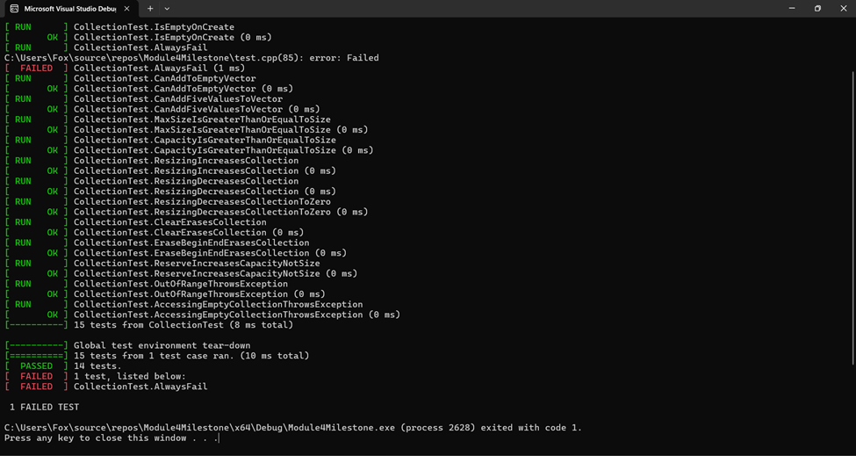
Unit Testing

Slide 11
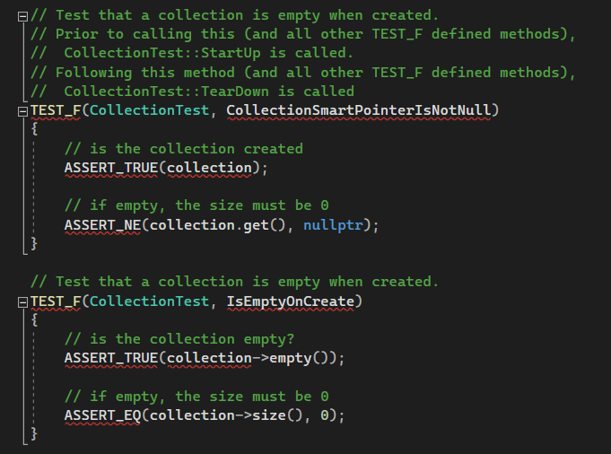

Slide 12

AUTOMATION SUMMARY

Slide 13
TOOLS
Plan
Design
Build
Test
Monitor
Static Code Analysis
Dependency Scanning
Monitoring

Slide 14
RISKS AND BENEFITS
Now or Later?
Assess
Propose Solutions
Taking Action, Risks and Benefits
Delaying Action Risks
Gaps

Slide 15
RECOMMENDATIONS
Incomplete Coverage
Incident Response
Lacking Physical Security Measures

Slide 16
CONCLUSIONS
From The Beginning
Defense-In-Depth
Triple-A Architecture

Slide 17
REFERENCES
Coding Standards
https://wiki.sei.cmu.edu/confluence/pages/viewpage.action?pageId=88046682

